Slide 1


Slide 2
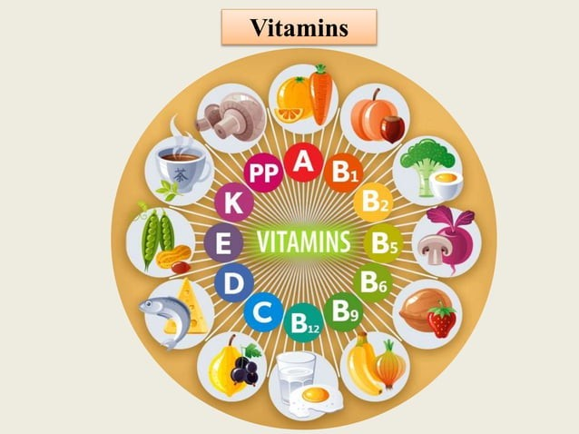

Slide 3


Vitamins are organic compounds that people need in small quantities. Most vitamins need to come from food because the body either does not produce them or produces very little.
Different vitamins play different roles in the body, and a person
requires a different amount of each vitamin to stay healthy.

Slide 4
Definition and Classification
Fat soluble vitamins
Found in the fats and oils of food.
Absorbed into the lymph and carried in blood with protein transporters = chylomicrons.
*Stored in liver and body fat and can become toxic if large amounts are consumed.

Slide 5
What is the difference between fat‐soluble and water‐soluble vitamins?
Fat‐soluble are stored in the liver and fatty tissues. These are not readily excreted from the body.
Water‐soluble vitamins travel in the blood and are stored in limited amounts. These are readily excreted from the body through urine.

Slide 6
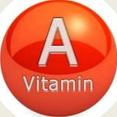
Vitamin-A
The chemical name is Retinol.
Found in foods of both plant and animal origin.
Function: It is essential for eye health.
Deficiency
Deficiency Syndrome
Decreased resistance io infection Dry scaly skin
Night blindness (Inability to see in dim light)
Bitot's spots- Greyish, rough and raised patches on conjunctiva Keratomalacia- Softening of the cornea.
Daily requirements: 0.4-1 mg Sources. Green leafy vegetables and yellow orange fruits and vegetables like mango, papaya, pumpkins and carrots are good sources of b-carotene.

Slide 7
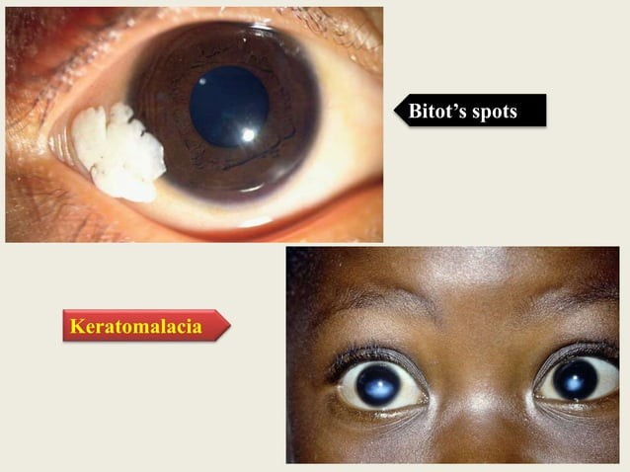

Slide 8


4 Vitamin D is synthesized by sunlight. n- Vitamin D is essential for bone growth.
Daily requirements: 400 IU Sources
4 Generated in the skin by action of ultra violet rays of sunlight
4 Food sources are milk, butter, cheese, egg, fish and fish liver oils, and foods which have been fortified by addition of vitamin D.
Functions
4• Increases intestinal absorption of calcium and phosphates.
•t• Mineralization of bones.
n• Vitamin D is also essential for the dental health. It prevents tooth decay and loss, strengthen the gums and reduces risk of any oral infection.

Slide 9





Can be found In foods
supplements, and exposure to sun
Reduces inflammation
Supports neuromuscular
funcclon
Studies have shown Vitamin D can help
rgspiratory InfectierI¿
Influences immune function

Slide 10
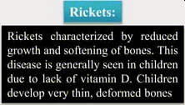
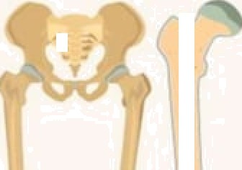
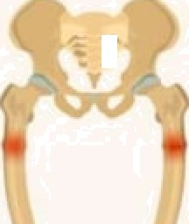



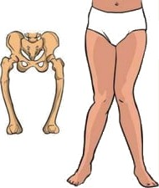
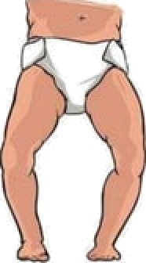


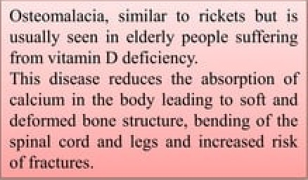


NORMAL b0NtS
RICKtTS
''calcium in .iíić 1iody.1cndirig to sort 'niid'

Slide 11
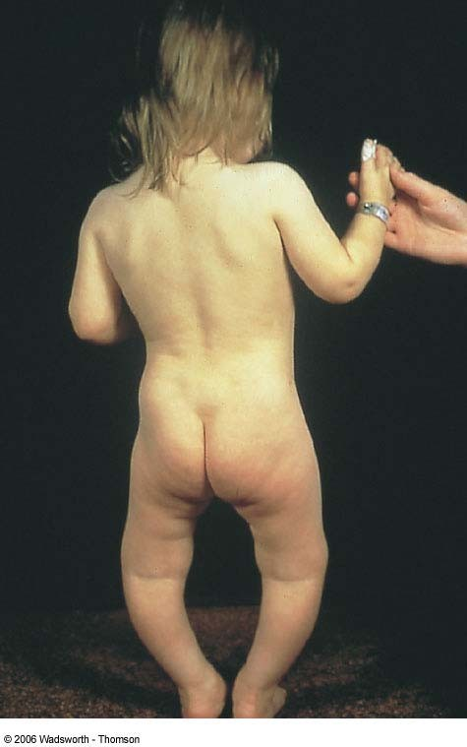
Bowed legs
–
Characteristi c of rickets
Fig. 7-5a, p. 222

Slide 12
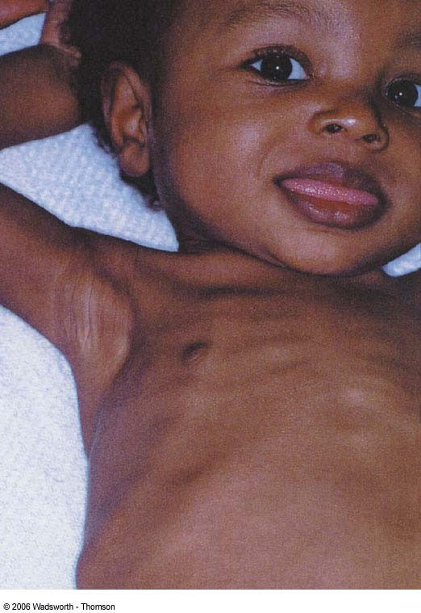
Beaded ribs
–
Characterist ic of rickets
Fig. 7-5b, p. 222

Slide 13
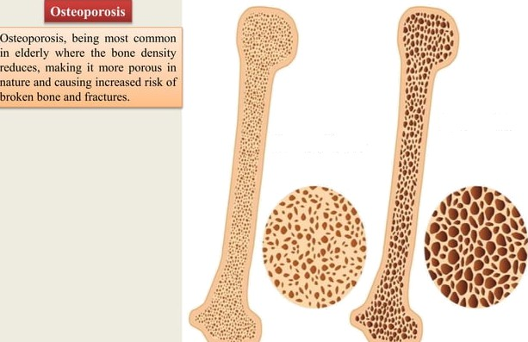
Bone with osteoporosis
OSTIOPOROSIS
Normal bone

Slide 14
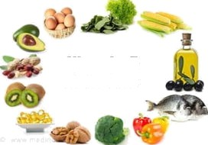

Vitamin E
Vitamin E is an aiTtioxidant and formed op of chemical substance
called Tocopherols.
Pick Foods
Daily requirements:
IEUR pci day.
Sources
Mick, oils, _{•s} •, lea fy vegetables, papaya, drains, nuts.
Functions
Antioxidant (Prcvcnts the formation of axidativc free mdical)
Co factor in clcctron transpo 1
Prevents ur dcluys tile ageing.

Slide 15
Fat Soluble Vitamins
Vitamin E – tocopherol, *alpha‐, beta ‐, gamma‐, and delta‐
Roles:
Antioxidant (protects polyunsaturated fats)
Prevention of damage to lungs, RBCs, WBCs (immunity), heart
Necessary for normal nerve development

Slide 16
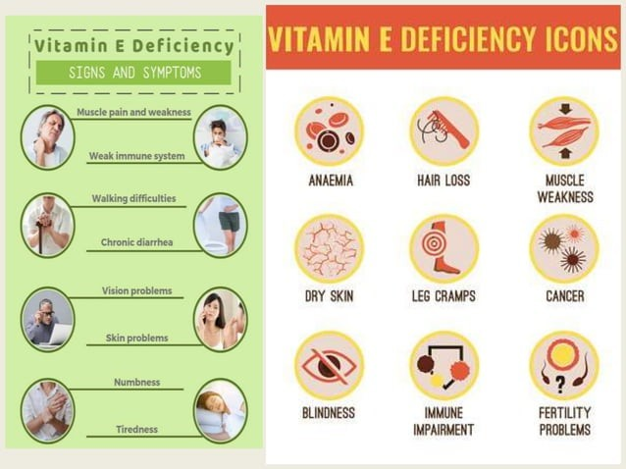

Slide 17
Fat Soluble Vitamins
Vitamin E
Deficiencies (decreased absorption of fats‐ liver disease, low fat diets)
Premature babies – fragile RBCs (hemolysis)
Loss of muscle coordination, vision, immune functions
Toxicities (more than 1000 milligrams/day)
Increases the effects of anticoagulants (Coumadin, Warfarin)

Slide 18
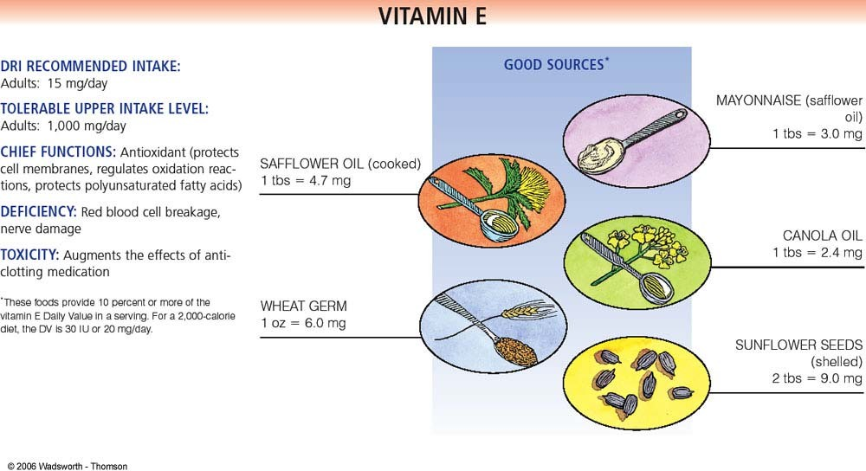
Snapshot 7-3, p, 226

Slide 19
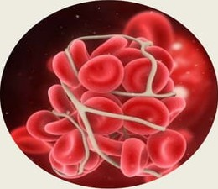
Vitamin K
It is called as Antihemorrhagic vitamin. It is required for the ftomation
of Prothrombin in the liver the 2"^{d} factor of coagulation.
Due to deficiency of Vit. K the prothronibin content in blood may lead to bleeding disorder.
Daily requirements
WHO suggested RDA of 55 pg per day for adults.
S0UfiC8S
Green leafy vegetables, cereals, fruits.

Slide 20
Fat Soluble Vitamins
Vitamin K – produced by bacteria in large intestine
Roles
Promotes synthesis of blood clotting proteins (**Interferes with Coumadin)
Bone formation
Deficiencies are rare but seen in infants, after prolonged antibiotic therapy, and in patients with decreased bile production.
Toxicities (>1000 mg/day): rupture of RBCs and jaundice

Slide 21
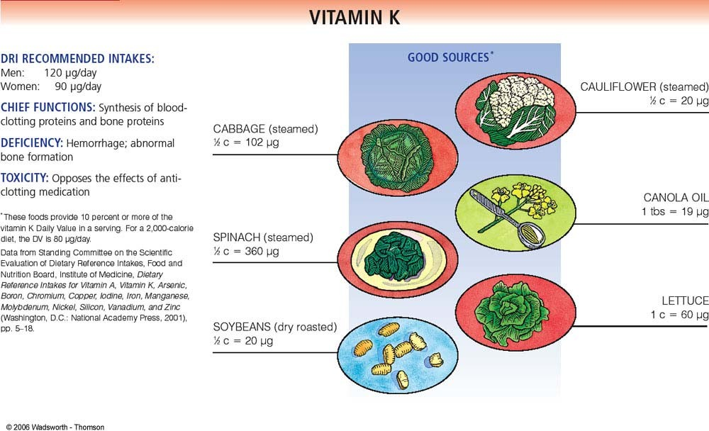
Snapshot 7-4, p, 228

Slide 22


